Slide 1
Lecture 3: Quantum simulation algorithms
Dominic Berry
Macquarie University

Slide 2
Simulation of Hamiltonians
1996
We want to simulate the evolution
$$|ψ_{t}〉=e^{−iHt}|ψ_{0}〉$$
The Hamiltonian is a sum of terms:
$$H=\sum_{ℓ=1}^{M}{H_{ℓ}}$$
Seth Lloyd
We can perform
$$e^{−iH_{ℓ}t}$$
For short times we can use
$$e^{−iH_{1}δt}e^{−iH_{2}δt}…e^{−iH_{M−1}δt}e^{−iH_{M}δt}≈e^{−iHδt}$$
For long times
$${\left[e^{−iH_{1}t/r}e^{−iH_{2}t/r}…e^{−iH_{M}t/r}\right]}^{r}{≈e}^{−iHt}$$

Slide 3
Simulation of Hamiltonians
1996
For short times we can use
$$e^{−iH_{1}δt}e^{−iH_{2}δt}…e^{−iH_{M−1}δt}e^{−iH_{M}δt}≈e^{−iHδt}$$
This approximation is because
$$e^{−iH_{1}δt}e^{−iH_{2}δt}…e^{−iH_{M−1}δt}e^{−iH_{M}δt}=\left(𝕀−iH_{1}δt+O\left(δt^{2}\right)\right)\left(𝕀−iH_{2}δt+O\left(δt^{2}\right)\right)… \\ …\left(𝕀−iH_{M}δt+O\left(δt^{2}\right)\right) \\ =𝕀−iH_{1}δt−iH_{2}δt…−iH_{M}δt+O\left(δt^{2}\right) \\ =𝕀−iHδt+O\left(δt^{2}\right) \\ =e^{−iHδt}+O(δt^{2})$$
If we divide long time $t$ into $r$ intervals, then
$$e^{−iHt}={\left(e^{−iHt/r}\right)}^{r}={\left[e^{−iH_{1}t/r}e^{−iH_{2}t/r}…e^{−iH_{M}t/r}+O\left({\left(t/r\right)}^{2}\right)\right]}^{r} \\ ={\left[e^{−iH_{1}t/r}e^{−iH_{2}t/r}…e^{−iH_{M}t/r}\right]}^{r}+O\left(t^{2}/r\right)$$
Typically, we want to simulate a system with some maximum allowable error $ε$.
Then we need $r∝t^{2}/ε$.
Seth Lloyd

Slide 4
Higher-order simulation
2007
Berry, Ahokas, Cleve, Sanders
A higher-order decomposition is
$$e^{−iH_{1}δt/2}…e^{−iH_{M−1}δt/2}e^{−iH_{M}δt/2}e^{−iH_{M}δt/2}e^{−iH_{M−1}δt/2}…e^{−iH_{1}δt/2}=e^{−iHδt}+O\left({\left[M\left\|H\right\|δt\right]}^{3}\right)$$
If we divide long time $t$ into $r$ intervals, then
$$e^{−iHt}={\left(e^{−iHt/r}\right)}^{r}={\left[e^{−iH_{1}t/2r}…e^{−iH_{M}t/2r}e^{−iH_{M}t/2r}…e^{−iH_{1}t/2r}+O\left({\left[M\left\|H\right\|t/r\right]}^{3}\right)\right]}^{r} \\ ={\left[e^{−iH_{1}t/2r}…e^{−iH_{M}t/2r}e^{−iH_{M}t/2r}…e^{−iH_{K1}t/2r}\right]}^{r}+O\left({\left[M\left\|H\right\|t\right]}^{3}/r^{2}\right)$$
Then we need $r∝{\left[M\left\|H\right\|t\right]}^{1.5}/\sqrt{ε}$.
General product formula can give error $O\left({\left[M\left\|H\right\|t/r\right]}^{2k+1}\right)$ for time $t/r$.
For time $t$ the error is $O\left({\left[M\left\|H\right\|t\right]}^{2k+1}/r^{2k}\right).$
To bound the error as $ε$ the value of $r$ scales as
$$r∝\frac{{\left[M\left\|H\right\|t\right]}^{1+1/2k}}{ε^{1/2k}}$$
The complexity is $r×M$.

Slide 5
Higher-order simulation
2007
Berry, Ahokas, Cleve, Sanders
$$r∝\frac{{\left[M\left\|H\right\|t\right]}^{1+1/2k}}{ε^{1/2k}}$$
The complexity is $r×M$.
For Sukuki product formulae, we have an additional factor in $r$
$$r∝\frac{{\left[5^{k}M\left\|H\right\|t\right]}^{1+1/2k}}{ε^{1/2k}}$$
The complexity then needs to be multiplied by a further factor of $5^{k}$.
The overall complexity scales as
$$\frac{{M5^{2k}\left[M\left\|H\right\|t\right]}^{1+1/2k}}{ε^{1/2k}}$$
We can also take an optimal value of $k∝\sqrt{\log\left(M\left\|H\right\|t/ε\right)}$, which gives scaling
$$M^{2}\left\|H\right\|t\exp{[2\sqrt{\ln{5}\ln{(M\left\|H\right\|t/ε)}}]}$$

Slide 6
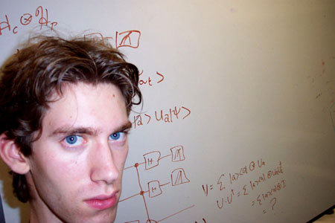
Solving linear systems
2009
Consider a large system of linear equations:
$$Ax=y$$
First assume that the matrix $A$ is Hermitian.
It is possible to simulate Hamiltonian evolution under $A$ for time $t$: $e^{−iAt}$.
Encode the initial state in the form
$$|y〉=\sum_{ℓ=1}^{N}{y_{ℓ}|ℓ〉}$$
The state can also be written in terms of the eigenvectors of $A$ as
$$|y〉=\sum_{k=1}^{N}{ψ_{k}|λ_{k}〉}$$
We can obtain the solution $|x〉$ if we can divide each $ψ_{k}$ by $λ_{k}$.
Use the phase estimation technique to place the estimate of $λ_{k}$ in an ancillary register to obtain
$$\sum_{k=1}^{N}{ψ_{k}|λ_{k}〉|{\hat{λ}}_{k}〉}$$
Harrow, Hassidim & Lloyd

Slide 7
Solving linear systems
2009
Use the phase estimation technique to place the estimate of $λ_{k}$ in an ancillary register to obtain
$$\sum_{k=1}^{N}{ψ_{k}|λ_{k}〉|{\hat{λ}}_{k}〉}$$
Append an ancilla and rotate it according to the value of $λ_{k}$ to obtain
$$\sum_{k=1}^{N}{ψ_{k}|λ_{k}〉|{\hat{λ}}_{k}〉\left(\frac{1}{λ_{k}}|0〉+\sqrt{1−\frac{1}{λ_{k}^{2}}}|1〉\right)}$$
Invert the phase estimation technique to remove the estimate of $λ_{k}$ from the ancillary register, giving
$$\sum_{k=1}^{N}{ψ_{k}|λ_{k}〉\left(\frac{1}{λ_{k}}|0〉+\sqrt{1−\frac{1}{λ_{k}^{2}}}|1〉\right)}$$
Use amplitude amplification to amplify the $|0〉$ component on the ancilla, giving a state proportional to
$$|x〉∝\sum_{k=1}^{N}{\frac{ψ_{k}}{λ_{k}}|λ_{k}〉}=\sum_{ℓ=1}^{N}{x_{ℓ}|ℓ〉}$$
Harrow, Hassidim & Lloyd

Slide 8
Solving linear systems
2009
What about non-Hermitian $A$?
Construct a blockwise matrix
$$A^{′}=\left[\begin{matrix}0 & A \\ A^{†} & 0\end{matrix}\right]$$
The inverse of $A′$ is then
$${\left(A^{′}\right)}^{−1}=\left[\begin{matrix}0 & {\left(A^{†}\right)}^{−1} \\ A^{−1} & 0\end{matrix}\right]$$
This means that
$$\left[\begin{matrix}0 & {\left(A^{†}\right)}^{−1} \\ A^{−1} & 0\end{matrix}\right]\left[\begin{matrix}y \\ 0\end{matrix}\right]=\left[\begin{matrix}0 \\ x\end{matrix}\right]$$
In terms of the state
$$|0〉|y〉↦|1〉|x〉$$
Harrow, Hassidim & Lloyd

Slide 9
Solving linear systems
2009
Complexity Analysis
We need to examine:
The complexity of simulating the Hamiltonian to estimate the phase.
The accuracy needed for the phase estimate.
The possibility of $1/λ_{k}$ being greater than $1$.
The complexity of simulating the Hamiltonian for time $t$ is approximately $∝\left\|A\right\|t=|λ_{max}|t$.
To obtain accuracy $δ$ in the estimate of $λ$, the Hamiltonian needs to be simulated for time $∝1/δ$.
We actually need to multiply the state coefficients by $\left|λ_{min}\right|/λ_{k}$, to give
$$\sum_{k=1}^{N}{\frac{|λ_{min}|}{λ_{k}}ψ_{k}|λ_{k}〉}$$
To obtain accuracy $ε$ in $\left|λ_{min}\right|/λ_{k}$, we need accuracy $ελ_{k}^{2}/\left|λ_{min}\right|$ in the estimate of $λ$.
Harrow, Hassidim & Lloyd
Final complexity is
$$∼\frac{κ^{2}}{ε}, κ:=\frac{{|λ}_{max}|}{|λ_{min}|}$$

Slide 10
Differential equations
2010
Berry
Discretise the differential equation, then encode as a linear system.
Simplest discretisation: Euler method.
⇒
sets initial condition
sets x to be constant

Slide 11
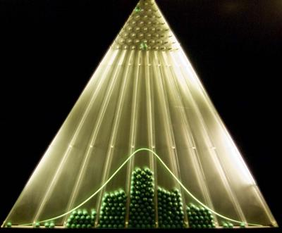
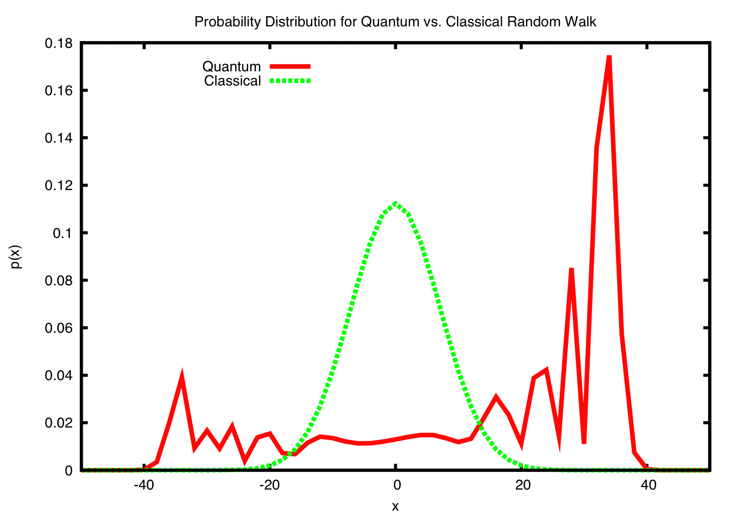
Quantum walks
A classical walk has a position which is an integer, $x$, which jumps either to the left or the right at each step.
The resulting distribution is a binomial distribution, or a normal distribution as the limit.
The quantum walk has position and coin values
$$|x,c〉$$
It then alternates coin and step operators, e.g.
$$C|x,±1〉=\left(|x,−1〉±|x,1〉\right)/\sqrt{2}$$
$$S|x,c〉=|x+c,c〉$$
The position can progress linearly in the number of steps.

Slide 12
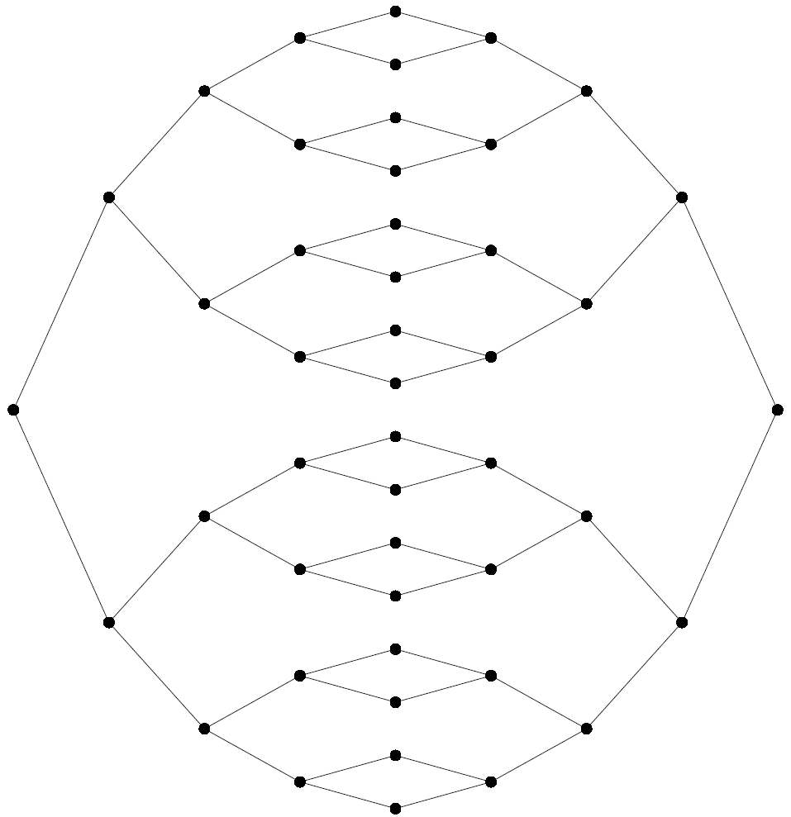
Quantum walk on a graph
The walk position is any node on the graph.
Describe the generator matrix $K$ by
$$K_{aa^{′}}=\left\{\begin{matrix}γ, \\ 0, \\ −d\left(a\right)γ,\end{matrix} \begin{matrix}a≠a^{′}, aa^{′}∈G \\ a≠a^{′}, aa^{′}∉G \\ a=a′\end{matrix}\right.$$
The quantity $d(a)$ is the number of edges incident on vertex $a$.
An edge between $a$ and $a^{′}$ is denoted $aa^{′}$.
The probability distribution for a continuous walk has the differential equation
$$\frac{dp_{a}\left(t\right)}{dt}=\sum_{a^{′}}{K_{aa^{′}}p_{a^{′}}(t)}$$

Slide 13
Quantum walk on a graph
1998
Farhi
$$\frac{dp_{a}\left(t\right)}{dt}=\sum_{a^{′}}{K_{aa^{′}}p_{a^{′}}(t)}$$
Quantum mechanically we have
$$i\frac{d}{dt}|ψ\left(t\right)〉=H|ψ\left(t\right)〉$$
$$i\frac{d}{dt}〈a|ψ\left(t\right)〉=\sum_{a^{′}}{〈a\left|H\right|a^{′}〉〈a′|ψ\left(t\right)〉}$$
The natural quantum analogue is
$$〈a\left|H\right|a^{′}〉=K_{aa^{′}}$$
We take
$$〈a\left|H\right|a^{′}〉=\left\{\begin{matrix}γ, \\ 0,\end{matrix} \begin{matrix}a≠a^{′}, aa^{′}∈G \\ otherwise.\end{matrix}\right.$$
Probability is conserved because $H$ is Hermitian.

Slide 14
Quantum walk on a graph
2002
Childs, Farhi, Gutmann
The goal is to traverse the graph from entrance to exit.
Classically the random walk will take exponential time.
For the quantum walk, define a superposition state
$$|col j〉=\frac{1}{\sqrt{N_{j}}}\sum_{a∈column j}{|a〉}$$
$$N_{j}=\left\{\begin{matrix}2^{j} & 0≤j≤n \\ 2^{2n+1−j} & n+1≤j≤2n+1\end{matrix}\right.$$
On these states the matrix elements of the Hamiltonian are
$$〈col j\left|H\right|col \left(j±1\right)〉=\sqrt{2}γ$$
entrance
exit

Slide 15
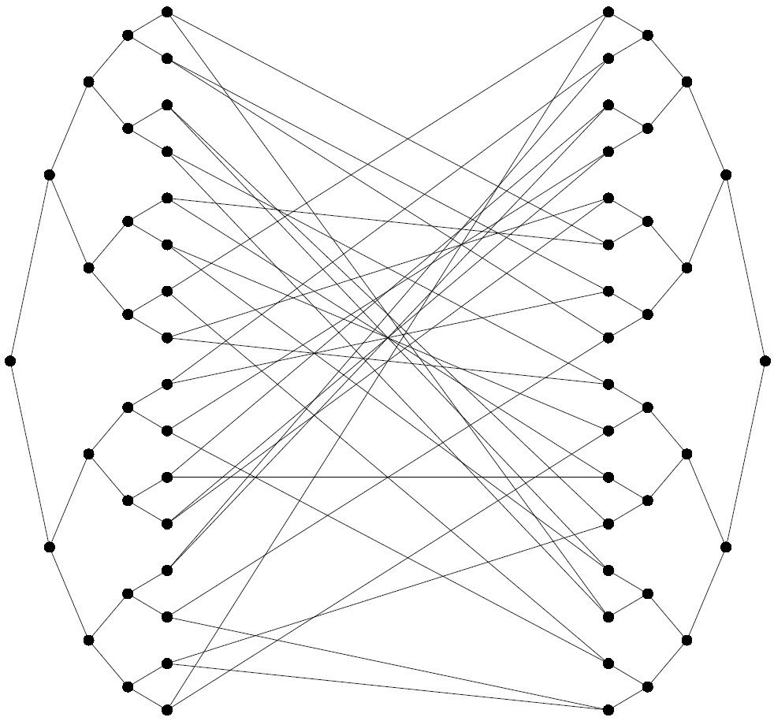
Quantum walk on a graph
2003
Childs, Cleve, Deotto, Farhi, Gutmann, Spielman
Add random connections between the two trees.
All vertices (except entrance and exit) have degree 3.
Again using column states, the matrix elements of the Hamiltonian are
$$〈col j\left|H\right|col \left(j±1\right)〉=\left\{\begin{matrix}\sqrt{2}γ & j≠n \\ 2γ & j=n\end{matrix}\right.$$
This is a line with a defect.
There are reflections off the defect, but the quantum walk still reaches the exit efficiently.
entrance
exit

Slide 16
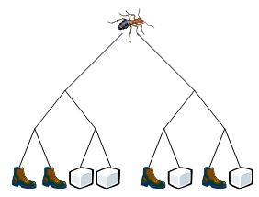
NAND tree quantum walk
2007
Farhi, Goldstone, Gutmann
In a game tree I alternate making moves with an opponent.
In this example, if I move first then I can always direct the ant to the sugar cube.
What is the complexity of doing this in general? Do we need to query all the leaves?
AND
OR
OR
AND
AND
AND
AND
$$x_{1}$$
$$x_{2}$$
$$x_{3}$$
$$x_{4}$$
$$x_{5}$$
$$x_{6}$$
$$x_{7}$$
$$x_{8}$$

Slide 17
NAND tree quantum walk
2007
Farhi, Goldstone, Gutmann
OR
OR
AND
_{NOT}
_{NOT}
AND
_{NOT}
_{NOT}
AND
AND
$$x_{1}$$
$$x_{2}$$
$$x_{3}$$
$$x_{4}$$
$$x_{1}$$
$$x_{2}$$
$$x_{3}$$
$$x_{4}$$
NAND
NAND
NAND
$$x_{1}$$
$$x_{2}$$
$$x_{3}$$
$$x_{4}$$

Slide 18
NAND tree quantum walk
2007
Farhi, Goldstone, Gutmann
wave
The Hamiltonian is a sum of an oracle Hamiltonian, representing the connections, and a fixed driving Hamiltonian, which is the remainder of the tree.
$$H=H_{O}+H_{D}$$
Prepare a travelling wave packet on the left.
If the answer to the NAND tree problem is $1$, then after a fixed time the wave packet will be found on the right.
The reflection depends on the solution of the NAND tree problem.

Slide 19
Simulating quantum walks
A more realistic scenario is that we have an oracle that provides the structure of the graph; i.e., a query to a node returns all the nodes that are connected.
The quantum oracle is queried with a node number $x$ and a neighbour number $j$.
It returns a result via the quantum operation
$$U_{O}|x,j〉|0〉=|x,j〉|y〉$$
Here $y$ is the $j$’th neighbour of $x$.
$$|x,j〉$$
$$U_{O}$$
$$|x,j〉$$
$$|0〉$$
$$|y〉$$
wave
connected nodes
query node

Slide 20
Decomposing the Hamiltonian
2003
Aharonov, Ta-Shma
In the matrix picture, we have a sparse matrix.
The rows and columns correspond to node numbers.
The ones indicate connections between nodes.
The oracle gives us the position of the $j$’th nonzero element in column $x$.
$$H=\left[\begin{matrix}0 & 0 & 1 & 0 & 0 & 1 & ⋯ & 0 \\ 0 & 1 & 0 & 0 & 0 & 1 & ⋯ & 0 \\ 1 & 0 & 0 & 0 & 0 & 0 & ⋯ & 1 \\ 0 & 0 & 0 & 1 & 1 & 0 & ⋯ & 0 \\ 0 & 0 & 0 & 1 & 1 & 0 & ⋯ & 0 \\ 1 & 1 & 0 & 0 & 0 & 0 & ⋯ & 0 \\ ⋮ & ⋮ & ⋮ & ⋮ & ⋮ & ⋮ & ⋱ & ⋮ \\ 0 & 0 & 1 & 0 & 0 & 0 & ⋯ & 1\end{matrix}\right]$$

Slide 21
Decomposing the Hamiltonian
2003
Aharonov, Ta-Shma
In the matrix picture, we have a sparse matrix.
The rows and columns correspond to node numbers.
The ones indicate connections between nodes.
The oracle gives us the position of the $j$’th nonzero element in column $x$.
We want to be able to separate the Hamiltonian into 1-sparse parts.
This is equivalent to a graph colouring – the graph edges are coloured such that each node has unique colours.
$$H=\left[\begin{matrix}0 & 0 & 1 & 0 & 0 & 1 & ⋯ & 0 \\ 0 & 1 & 0 & 0 & 0 & 1 & ⋯ & 0 \\ 1 & 0 & 0 & 0 & 0 & 0 & ⋯ & 1 \\ 0 & 0 & 0 & 1 & 1 & 0 & ⋯ & 0 \\ 0 & 0 & 0 & 1 & 1 & 0 & ⋯ & 0 \\ 1 & 1 & 0 & 0 & 0 & 0 & ⋯ & 0 \\ ⋮ & ⋮ & ⋮ & ⋮ & ⋮ & ⋮ & ⋱ & ⋮ \\ 0 & 0 & 1 & 0 & 0 & 0 & ⋯ & 1\end{matrix}\right]$$

Slide 22
Graph colouring
2007
Berry, Ahokas, Cleve, Sanders
How do we do this colouring?
First guess: for each node, assign edges sequentially according to their numbering.
This does not work because the edge between nodes $x$ and $y$ may be edge $1$ (for example) of $x$, but edge $2$ of $y$.
Second guess: for edge between $x$ and $y$, colour it according to the pair of numbers $(j_{x},j_{y})$, where it is edge $j_{x}$ of node $x$ and edge $j_{y}$ of node $y$.
We decide the order such that $x<y$.
It is still possible to have ambiguity: say we have $x<y<z$.
$$H=\left[\begin{matrix}0 & 0 & 1 & 0 & 0 & 1 & ⋯ & 0 \\ 0 & 1 & 0 & 0 & 0 & 1 & ⋯ & 0 \\ 1 & 0 & 0 & 0 & 0 & 0 & ⋯ & 1 \\ 0 & 0 & 0 & 1 & 1 & 0 & ⋯ & 0 \\ 0 & 0 & 0 & 1 & 1 & 0 & ⋯ & 0 \\ 1 & 1 & 0 & 0 & 0 & 0 & ⋯ & 0 \\ ⋮ & ⋮ & ⋮ & ⋮ & ⋮ & ⋮ & ⋱ & ⋮ \\ 0 & 0 & 1 & 0 & 0 & 0 & ⋯ & 1\end{matrix}\right]$$

Slide 23
Graph colouring
2007
Berry, Ahokas, Cleve, Sanders
How do we do this colouring?
First guess: for each node, assign edges sequentially according to their numbering.
This does not work because the edge between nodes $x$ and $y$ may be edge $1$ (for example) of $x$, but edge $2$ of $y$.
Second guess: for edge between $x$ and $y$, colour it according to the pair of numbers $(j_{x},j_{y})$, where it is edge $j_{x}$ of node $x$ and edge $j_{y}$ of node $y$.
We decide the order such that $x<y$.
It is still possible to have ambiguity: say we have $x<y<z$.
$$H=\left[\begin{matrix}0 & 0 & 1 & 0 & 0 & 1 & ⋯ & 0 \\ 0 & 1 & 0 & 0 & 0 & 1 & ⋯ & 0 \\ 1 & 0 & 0 & 0 & 0 & 0 & ⋯ & 1 \\ 0 & 0 & 0 & 1 & 1 & 0 & ⋯ & 0 \\ 0 & 0 & 0 & 1 & 1 & 0 & ⋯ & 0 \\ 1 & 1 & 0 & 0 & 0 & 0 & ⋯ & 0 \\ ⋮ & ⋮ & ⋮ & ⋮ & ⋮ & ⋮ & ⋱ & ⋮ \\ 0 & 0 & 1 & 0 & 0 & 0 & ⋯ & 1\end{matrix}\right]$$
$$x$$
$$3$$
$$2$$
$$1$$
$$(1,2)$$
$$2$$
$$y$$
$$3$$
$$(1,2)$$
$$z$$
$$1$$
$$2$$
$$3$$
$$1$$
Use a string of nodes with equal edge colours, and compress.

Slide 24
General Hamiltonian oracles
2003
Aharonov, Ta-Shma
$$H=\left[\begin{matrix}0 & 0 & 2 & 0 & 0 & \sqrt{2}i & ⋯ & 0 \\ 0 & 3 & 0 & 0 & 0 & 1/2 & ⋯ & 0 \\ 2 & 0 & 0 & 0 & 0 & 0 & ⋯ & −\sqrt{3}+i \\ 0 & 0 & 0 & 1 & e^{iπ/7} & 0 & ⋯ & 0 \\ 0 & 0 & 0 & e^{−iπ/7} & 2 & 0 & ⋯ & 0 \\ −\sqrt{2}i & 1/2 & 0 & 0 & 0 & 0 & ⋯ & 0 \\ ⋮ & ⋮ & ⋮ & ⋮ & ⋮ & ⋮ & ⋱ & ⋮ \\ 0 & 0 & −\sqrt{3}−i & 0 & 0 & 0 & ⋯ & 1/10\end{matrix}\right]$$
More generally, we can perform a colouring on a graph with matrix elements of arbitrary (Hermitian) values.
Then we also require an oracle to give us the values of the matrix elements.
$$|x,j〉$$
$$|x,j〉$$
$$U_{O}$$
$$|0〉$$
$$|y〉$$
$$|x,y〉$$
$$U_{H}$$
$$|x,y〉$$
$$|0〉$$
$$|H_{x,y}〉$$

Slide 25
Simulating 1-sparse case
2003
Aharonov, Ta-Shma
$$H=\left[\begin{matrix}0 & 0 & 0 & 0 & 0 & \sqrt{2}i & ⋯ & 0 \\ 0 & 3 & 0 & 0 & 0 & 0 & ⋯ & 0 \\ 0 & 0 & 0 & 0 & 0 & 0 & ⋯ & −\sqrt{3}+i \\ 0 & 0 & 0 & 1 & 0 & 0 & ⋯ & 0 \\ 0 & 0 & 0 & 0 & 2 & 0 & ⋯ & 0 \\ −\sqrt{2}i & 0 & 0 & 0 & 0 & 0 & ⋯ & 0 \\ ⋮ & ⋮ & ⋮ & ⋮ & ⋮ & ⋮ & ⋱ & ⋮ \\ 0 & 0 & −\sqrt{3}−i & 0 & 0 & 0 & ⋯ & 0\end{matrix}\right]$$
Assume we have a 1-sparse matrix.
How can we simulate evolution under this Hamiltonian?
Two cases:
If the element is on the diagonal, then we have a 1D subspace.
If the element is off the diagonal, then we need a 2D subspace.

Slide 26
Simulating 1-sparse case
2003
Aharonov, Ta-Shma
We are given a column number $x$. There are then 5 quantities that we want to calculate:
$b_{x}$: A bit registering whether the element is on or off the diagonal; i.e. $x$ belongs to a 1D or 2D subspace.
$\min_{x}$: The minimum number out of the (1D or 2D) subspace to which $x$ belongs.
$\max_{x}$: The maximum number out of the subspace to which $x$ belongs.
$A_{x}$: The entries of $H$ in the subspace to which $x$ belongs.
$U_{x}$: The evolution under $H$ for time $t$ in the subspace.
We have a unitary operation that maps
$$|x〉|0〉→|x〉|b_{x},\min_{x},\max_{x},{\tilde{A}}_{x},{\tilde{U}}_{x}〉$$

Slide 27
Simulating 1-sparse case
2003
Aharonov, Ta-Shma
We have a unitary operation that maps
$$|x〉|0〉→|x〉|b_{x},\min_{x},\max_{x},{\tilde{A}}_{x},{\tilde{U}}_{x}〉$$
We consider a superposition of the two states in the subspace,
$$|ψ〉=μ|\min_{x}〉+ν|\max_{x}〉$$
Then we obtain
$$|ψ〉|0〉→|ψ〉|b_{x},\min_{x},\max_{x},{\tilde{A}}_{x},{\tilde{U}}_{x}〉$$
A second operation implements the controlled operation based on the stored approximation of the unitary operation ${\tilde{U}}_{x}$:
$$|ψ〉|{\tilde{U}}_{x},\min_{x},\max_{x}〉→{\tilde{U}}_{x}|ψ〉|{\tilde{U}}_{x},\min_{x},\max_{x}〉$$
This gives us
$${\tilde{U}}_{x}|ψ〉|b_{x},\min_{x},\max_{x},{\tilde{A}}_{x},{\tilde{U}}_{x}〉$$
Inverting the first operation then yields
$${\tilde{U}}_{x}|ψ〉|0〉$$

Slide 28
Applications
2007: Discrete query NAND algorithm – Childs, Cleve, Jordan, Yeung
2009: Solving linear systems – Harrow, Hassidim, Lloyd
2009: Implementing sparse unitaries – Jordan, Wocjan
2010: Solving linear differential equations – Berry
2013: Algorithm for scattering cross section – Clader, Jacobs, Sprouse

Slide 29
Implementing unitaries
2009
Jordan, Wocjan
Construct a Hamiltonian from unitary as
$$H=\left[\begin{matrix}0 & U \\ U^{†} & 0\end{matrix}\right]$$
Now simulate evolution under this Hamiltonian
$$e^{−iHt}=𝕀\cos{t}−iH\sin{t}$$
Simulating for time $t=π/2$ gives
$$e^{−iHπ/2}|1〉|ψ〉=−iH|1〉|ψ〉=−i|0〉U|ψ〉$$

Slide 30
Quantum simulation via walks
Three ingredients:
1. A Szegedy quantum walk
2. Coherent phase estimation
3. Controlled state preparation
The quantum walk has eigenvalues and eigenvectors related to those for Hamiltonian.
By using phase estimation, we can estimate the eigenvalue, then implement that actually needed.

Slide 31
Szegedy Quantum Walk
2004
Szegedy
The walk uses two reflections
$$2CC^{†}−𝕀$$
$$2RR^{†}−𝕀$$
The first is controlled by the first register and acts on the second register.
Given some matrix $c[i,j]$, the operator $C$ is defined by
$$|c_{i}〉=\sum_{j=1}^{N}{\sqrt{c[i,j]}|j〉}$$
$$C=\sum_{i=1}^{N}{|i〉〈i|⊗|c_{i}〉}$$

Slide 32
Szegedy Quantum Walk
2004
Szegedy
The diffusion operator $2RR^{†}−𝕀$ is controlled by the second register and acts on the first. Use a similar definition with matrix $r[i,j]$.
Both are controlled reflections:
$$2CC^{†}−𝕀=\sum_{i=1}^{N}{|i〉〈i|⊗(2|c_{i}〉〈c_{i}|−𝕀)}$$
$$2RR^{†}−𝕀=\sum_{i=1}^{N}{ (2|r_{i}〉〈r_{i}|−𝕀)⊗|i〉〈i|}$$
The eigenvalues and eigenvectors of the step of the quantum walk
$$(2CC^{†}−𝕀)(2RR^{†}−𝕀)$$
are related to those of a matrix formed from $c[i,j]$ and $r[i,j]$.

Slide 33
Szegedy walk for simulation
2012
Berry, Childs
Use symmetric system, with
$$c\left[i,j\right]=r\left[i,j\right]=H_{ij}^{∗}$$
Then eigenvalues and eigenvectors are related to those of Hamiltonian.
In reality we need to modify to “lazy” quantum walk, with
$$|c_{i}〉=\sqrt{\frac{δ}{{\left\|H\right\|}_{1}}}\sum_{j=1}^{N}{\sqrt{H_{ij}^{∗}}|j〉}+\sqrt{1−\frac{σ_{i}δ}{{\left\|H\right\|}_{1}}}|N+1〉 σ_{i}≔\sum_{j=1}^{N}{|H_{ij}|}$$
Grover preparation gives
$$|ψ^{b}〉=\frac{1}{\sqrt{N}}\sum_{k=1}^{N}{|k〉\left(ψ_{k}|0〉+\sqrt{1−{\left|ψ_{k}\right|}^{2}}|1〉\right)}$$

Slide 34
Szegedy walk for simulation
2012
Berry, Childs
Three step process:
1. Start with state in one of the subsystems, and perform controlled state preparation.
2. Perform steps of quantum walk to approximate Hamiltonian evolution.
3. Invert controlled state preparation, so final state is in one of the subsystems.
Step 2 can just be performed with small $δ$ for lazy quantum walk, or can use phase estimation.
A Hamiltonian has eigenvalues $μ$, so evolution under the Hamiltonian has eigenvalues
$$e^{−iμT}$$
$V$ is the step of a quantum walk, and has eigenvalues
$$e^{iλ}=±e^{±i\arcsin{μδ} }$$
The complexity is the maximum of
$$\frac{\left\|H\right\|T}{\sqrt{ε}} d{\left\|H\right\|}_{max}T$$

