Slide 1
Polylog Hamiltonian simulation
Dominic Berry
Macquarie University
Richard Cleve
IQC
Rolando Somma
LANL

Slide 2
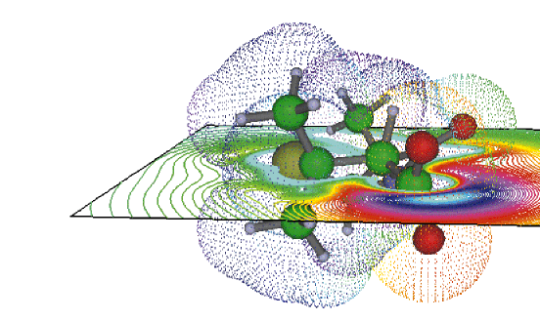
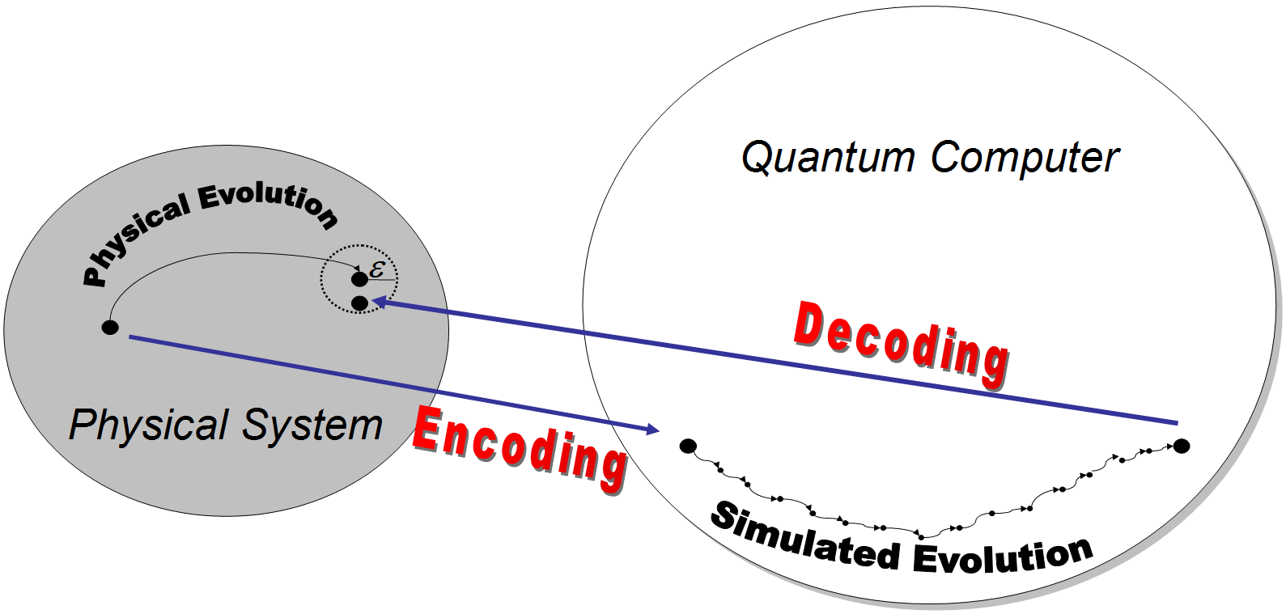
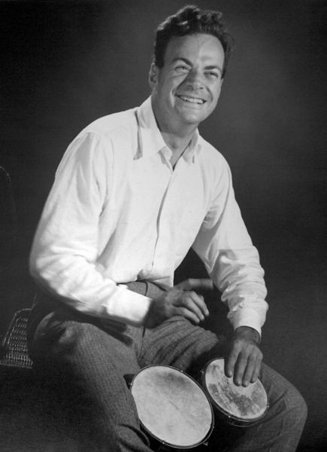
Simulation of Hamiltonians
Quantum computers could give an exponential speedup in the simulation of quantum physical systems.
This is the original reason why Feynman proposed the idea of quantum computers.
The state of the system is encoded into the quantum computer.
Richard Feynman

Slide 3
Simulation of Hamiltonians
Two scenarios:
The Hamiltonian is given as a sum of interaction terms:
$$H=\sum_{j}{H_{j}}$$
The Hamiltonian is sparse, in that it has no more than $d$ nonzero elements in any row or column.
Richard Feynman

Slide 4
Standard Methods
Decompose the Hamiltonian as
$$H=\sum_{k=1}^{M}{H_{k}}$$
The individual Hamiltonians $H_{k}$ can be limited-dimension interaction Hamiltonians (Lloyd, 1996).
Approximate evolution for short time as
$$e^{−iHT}=\prod_{k=1}^{M}{e^{−iH_{k}T}}$$
For longer times, we divide the time up into many short times
$$e^{−iHT}={\left(\prod_{k=1}^{M}{e^{−iH_{k}T/r}}\right)}^{r}$$
S. Lloyd, Science 273, 1073 (1996).

Slide 5
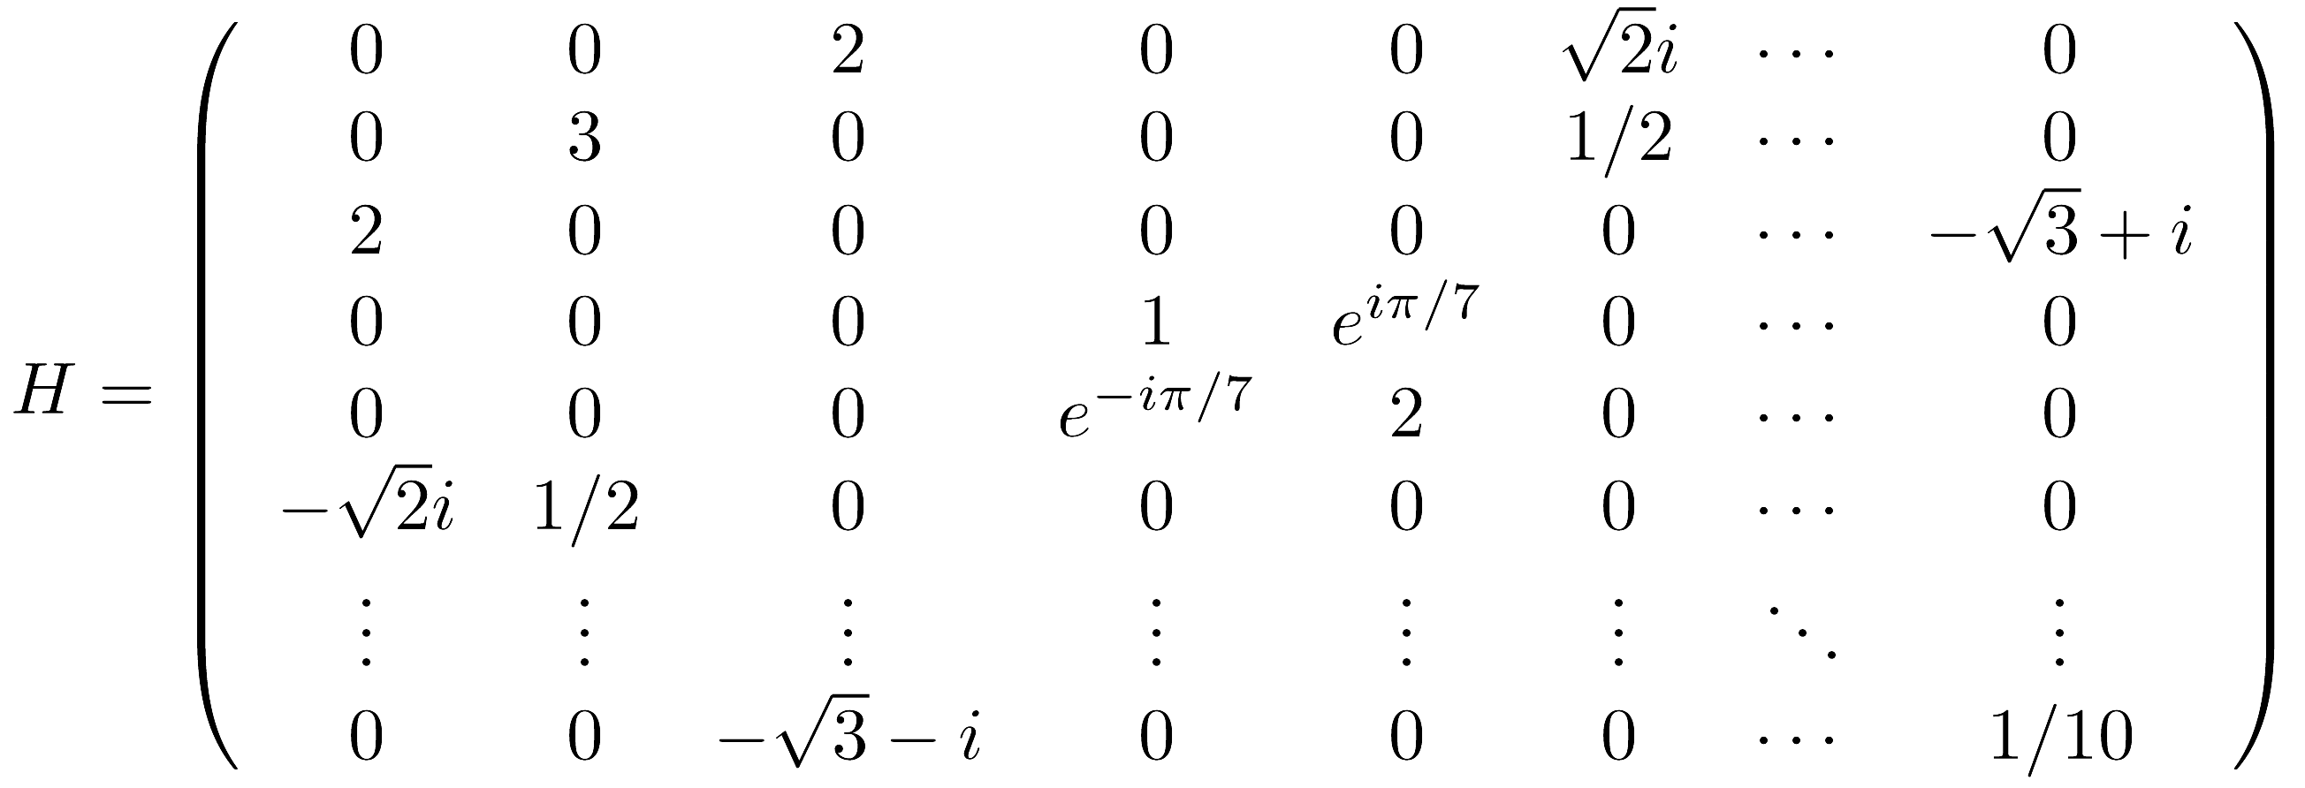
Standard Methods
More generally, we would like to be able to simulate sparse Hamiltonians.
Positions and values of non-zero elements are given by oracle.
This enables application to many other problems.
$$U_{BB}$$
$$|j,k〉$$
$$|j,k〉$$
$$|0〉$$
$$|H_{jk}〉$$

Slide 6
Standard Methods
The individual $H_{k}$ can be 1-sparse Hamiltonians obtained by a decomposition technique (Aharonov & Ta-Shma, 2003).
Efficiency can be increased by improved decomposition techniques (Berry, Ahokas, Cleve, Sanders, 2007; Childs & Kothari, 2010).
Higher-order decomposition formulae can also be used to obtain greater efficiency (Berry, Ahokas, Cleve, Sanders, 2007).
D. Aharonov and Ta-Shma, STOC 2003; quant-ph/0301023 (2003).
D. W. Berry, G. Ahokas, R. Cleve, and B. C. Sanders, Comm. Math. Phys. 270, 359 (2007).
A. M. Childs and R. Kothari, TQC 2010, Lecture Notes in Computer Science 6519, 94 (2011).

Slide 7
Quantities involved in simulation
We want to simulation quantum evolution under a Hamiltonian
$$\frac{d}{dt}\left|ψ\right\rangle =−iH(t)\left|ψ\right\rangle$$
$ε\text{ – }\text{allowable} \text{error} \text{in} \text{the} \text{simulation}$
$T\text{ – }\text{time} \text{of} \text{evolution} \text{under} \text{the} \text{Hamiltonian}$
$d$ – sparseness, i.e. maximum number of nonzero elements
$\left\|H\right\|$ – norm of the Hamiltonian to be simulated
$\left\|H^{′}\right\|$ – norm of the time-derivative of the Hamiltonian
$N$ – dimension of the system

Slide 8
Standard Methods - Limitations
The scaling is always polynomial in the allowable error, $ε$.
The scaling for time-dependent Hamiltonians depends heavily on the derivatives of the Hamiltonian.
The scaling in $T$ is always superlinear, whereas lower bound is linear in $T$.
The scaling is at best $d^{3}$ in the sparseness.

Slide 9
Known results
It is possible to decompose a sparse Hamiltonian into $O(d^{2})$ 1-sparse Hamiltonians with complexity $O(\log^{∗}{n})$[1].
This can be improved to $O(d)$ Hamiltonians, at the cost of complexity linear in $d$ [2].
Arbitrary order Lie-Trotter-Suzuki formulae can be used to obtain scaling as $O({(\left\|H\right\|T)}^{1+1/2k})$ for arbitrarily large integer $k$. The scaling in terms of the allowable error is $O(1/ε^{1/2k})$ [1].
Using quantum walks without a decomposition enables complexity strictly linear in $\left\|H\right\|T$, but as scaling in the error of $O(1/\sqrt{ε})$ [3].
Similar scaling can be obtained for time-dependent Hamiltonians, but the complexity now depends on the higher-order derivatives [4].
An algorithm with randomised times enables complexity independent of the derivatives of the Hamiltonian, at the expense of worse scaling in $ε$ [5].
[1] D. W. Berry, G. Ahokas, R. Cleve, and B. C. Sanders, Comm. Math. Phys. 270, 359 (2007).
[2] A. M. Childs and R. Kothari, TQC 2010, Lecture Notes in Computer Science 6519, 94 (2011).
[3] D. W. Berry and A. M. Childs, Quantum Information and Computation 12, 29 (2012).
[4] N. Wiebe, D. W. Berry, P. Høyer, and B. C. Sanders, J. Phys. A: Math. Theor. 43, 065203 (2010).
[5] D. Poulin, A. Qarry, R. D. Somma, and F. Verstraete, Phys. Rev. Lett. 106, 170501 (2011).

Slide 10
Main result
We obtain scaling as
$$O\left(d^{2}\left\|H\right\|T×polylog\right)$$
Advances over prior work:
The scaling is polylog in the error – something which has never been achieved before.
The scaling is only polylog in the derivative of the Hamiltonian – independence had been achieved before, but at the expense of poor scaling in $ε$ and $\left\|H\right\|T$ [5].
The scaling is linear in $\left\|H\right\|T$ up to a polylog factor – linear scaling had been achieved before, but with poor scaling in $ε$ [3].
The scaling in $d$ is better than has been achieved before, except in [3].
[1] D. W. Berry, G. Ahokas, R. Cleve, and B. C. Sanders, Comm. Math. Phys. 270, 359 (2007).
[2] A. M. Childs and R. Kothari, TQC 2010, Lecture Notes in Computer Science 6519, 94 (2011).
[3] D. W. Berry and A. M. Childs, Quantum Information and Computation 12, 29 (2012).
[4] N. Wiebe, D. W. Berry, P. Høyer, and B. C. Sanders, J. Phys. A: Math. Theor. 43, 065203 (2010).
[5] D. Poulin, A. Qarry, R. D. Somma, and F. Verstraete, Phys. Rev. Lett. 106, 170501 (2011).

Slide 11
Main result
We obtain scaling as
$$O\left(d^{2}\left\|H\right\|T×polylog\right)$$
Method:
Decompose Hamiltonian into 1-sparse Hamiltonians as in [1].
Use a low-order Lie-Trotter expansion of the evolution into a product of evolutions under these self-inverse Hamiltonians.
Further decompose Hamiltonian into a sum of self-inverse Hamiltonians.
Use method from [2] to turn Trotter decomposition into discrete steps at a superposition of times.
Use method from [3] to perform measurements efficiently.
[1] D. W. Berry, G. Ahokas, R. Cleve, and B. C. Sanders, Comm. Math. Phys. 270, 359 (2007).
[2] R. Cleve, D. Gottesman, M. Mosca, R. Somma, and D. Yonge-Mallo, In Proc. 41st ACM Symposium on Theory of Computing, pp. 409-416 (2009).
[3] D. W. Berry, R. Cleve, and S. Gharibian, arXiv:1211.4637 (2012).

Slide 12
1. Decompose Hamiltonian to 1-sparse
Sparse Hamiltonian has no more than $d$ nonzero elements in any row or column, e.g. $d=2$
A 1-sparse Hamiltonian has no more than one nonzero element.
We could decompose Hamiltonian into $H_{1}$ and $H_{2}$ shown in blue and yellow.
In general we can decompose into $6d^{2}$ parts.
D. W. Berry, G. Ahokas, R. Cleve, and B. C. Sanders, Comm. Math. Phys. 270, 359 (2007).

Slide 13
2. Decompose 1-sparse to self-inverse
We further divide the 1-sparse Hamiltonian into $X$, $Y$ and $Z$ components, in this example for $H_{1}$.
The $X$ and $Y$ components are proportional to Pauli $X$ and $Y$ matrices in each $2×2$subspace.
The $Z$ component is a phase shift in a $1×1$ subspace.
off-diagonal real
$$H_{1}$$
off-diagonal imaginary
on-diagonal real

Slide 14
2. Decompose 1-sparse to self-inverse
Consider just the $X$ component. We further decompose it into components of magnitude ${2ε}_{H}$.
Take $ε_{H}=1/4$. Then we can approximate
$$−\sqrt{3}≈−\frac{1}{2}−\frac{1}{2}−\frac{1}{2}+0$$
$$H_{1,X}$$
take component 2

Slide 15
2. Decompose 1-sparse to self-inverse
Consider just the $X$ component. We further decompose it into components of magnitude ${2ε}_{H}$.
Take $ε_{H}=1/4$. Then we can approximate
$$−\sqrt{3}≈−\frac{1}{2}−\frac{1}{2}−\frac{1}{2}+0$$
$$−1/2$$
$$H_{1,X,2}$$
$$−1/2$$
take component 2

Slide 16
2. Decompose 1-sparse to self-inverse
To obtain self-inverse matrices, we want $+1$ or $−1$ to appear in each column once.
We further expand
$$\frac{1}{2}=\frac{1}{4}+\frac{1}{4} −\frac{1}{2}=−\frac{1}{4}−\frac{1}{4} 0=\frac{1}{4}−\frac{1}{4}$$
$$−1/2$$
$$H_{1,X,2}$$
$$−1/2$$

Slide 17
2. Decompose 1-sparse to self-inverse
To obtain self-inverse matrices, we want $+1$ or $−1$ to appear in each column once.
We further expand
$$\frac{1}{2}=\frac{1}{4}+\frac{1}{4} −\frac{1}{2}=−\frac{1}{4}−\frac{1}{4} 0=\frac{1}{4}−\frac{1}{4}$$
To make it 1-sparse we fill in on the diagonal as needed.
$$1/4$$
$$1/4$$
$$−1/4$$
$$1/4$$
$$H_{1,X,2,+}$$
$$1/4$$
$$1/4$$
$$−1/4$$
take first component

Slide 18
2. Decompose 1-sparse to self-inverse
To obtain self-inverse matrices, we want $+1$ or $−1$ to appear in each column once.
We further expand
$$\frac{1}{2}=\frac{1}{4}+\frac{1}{4} −\frac{1}{2}=−\frac{1}{4}−\frac{1}{4} 0=\frac{1}{4}−\frac{1}{4}$$
To make it 1-sparse we fill in on the diagonal as needed.
$1$
$1$
$$−1$$
$1$
$$H_{1,X,2,+}$$
$$ε_{H}$$
$1$
$1$
$$−1$$
take first component

Slide 19
3. Trotter expansion
The Hamiltonian evolution is
$$exp⁡(−i(H_{1}+H_{2})T)$$
More generally time-dependent evolution
$$\exp\left[−i\int_{0}^{T}{\left(H_{1}(t)+H_{2}(t)\right)dt}\right]$$
This can be thought of as the limit of a large number, $r$, of small intervals.
$$\lim_{r→∞}{\prod_{j=1}^{r}{e^{−iH_{1}(t_{j})δt}e^{−iH_{2}(t_{j})δt}}}$$
We can approximate the time evolution using finite $r$. The error scales as
$$O\left(\frac{{\left(ΛT\right)}^{2}}{r}\right)$$
To bound error by $ε$, can use
$$r∝\frac{{\left(ΛT\right)}^{2}}{ε}$$
time ordering
T
$$t_{j}=jδt$$
$$δt=T/r$$
$$Λ=\max{(\left\|H\right\|,\left\|H′\right\|)}$$

Slide 20
4. Using CGMSY’09 technique
$H_{1}=ε_{H}U_{1}$, where $U_{1}$ is self-inverse, so
$$e^{−iH_{1}δt}=𝕀\cos{θ}−iU_{1}\sin{θ}$$
Implement the operation probabilistically with a control qubit.
$$θ=ε_{H}δt$$
$$\sqrt{\cos{θ}}|0〉−i\sqrt{\sin{θ}}|1〉$$
$$\sqrt{\cos{θ}}〈0|+\sqrt{\sin{θ}}〈1|$$
$$|ψ〉$$
$$U_{1}$$
$$e^{−iH_{1}δt}|ψ〉$$
R. Cleve, D. Gottesman, M. Mosca, R. Somma, and D. Yonge-Mallo, In Proc. 41st ACM Symposium on Theory of Computing, pp. 409-416 (2009).

Slide 21
4. Using CGMSY’09 technique
$H_{1}=ε_{H}U_{1}$, where $U_{1}$ is self-inverse, so
$$e^{−iH_{1}δt}=𝕀\cos{θ}−iU_{1}\sin{θ}$$
Implement the operation probabilistically with a control qubit.
$$θ=ε_{H}δt$$
$$R=\left(\begin{matrix}α & β \\ β & −α\end{matrix}\right)$$
$$β=\sqrt{\sin{θ}}$$
$$|0〉$$
$$R$$
$$P$$
$$R$$
$$〈0|$$
$$P=\left(\begin{matrix}1 & 0 \\ 0 & −i\end{matrix}\right)$$
$$|ψ〉$$
$$U_{1}$$
$$e^{−iH_{1}δt}|ψ〉$$
R. Cleve, D. Gottesman, M. Mosca, R. Somma, and D. Yonge-Mallo, In Proc. 41st ACM Symposium on Theory of Computing, pp. 409-416 (2009).

Slide 22
4. Using CGMSY’09 technique
Dividing the time into segments of length $1/4$, the probability of success for any segment is $≥3/4$.
$m=r/4T$ intervals in segment of length $1/4$
$r$ Trotter intervals over total time $T$
0
$$\frac{1}{4}$$
$$\frac{2}{4}$$
$$\frac{3}{4}$$
1
$$\frac{5}{4}$$
$$\frac{6}{4}$$
$$\frac{7}{4}$$
2
$$\frac{9}{4}$$
$$\frac{10}{4}$$
. . . . . . . . . . . . .
T
R. Cleve, D. Gottesman, M. Mosca, R. Somma, and D. Yonge-Mallo, In Proc. 41st ACM Symposium on Theory of Computing, pp. 409-416 (2009).

Slide 23
4. Using CGMSY’09 technique
$$|0〉$$
$R$
$R$
measure
$$b_{1}$$
$$b_{2}$$
$$b_{3}$$
$$b_{4}$$
.
.
.
$$b_{m}$$
$$|0〉$$
$R$
$R$
$$|0〉$$
$R$
$R$
$$|0〉$$
$R$
$R$
$$|0〉$$
$R$
$R$
$$|0〉$$
$R$
$R$
$$|0〉$$
$R$
$R$
$m$ qubits
$$|0〉$$
$R$
$R$
$$|0〉$$
$R$
$R$
$$|0〉$$
$R$
$R$
$$|0〉$$
$R$
$R$
$$|0〉$$
$R$
$R$
$$|0〉$$
$R$
$R$
$$|0〉$$
$R$
$R$
$$|0〉$$
$R$
$R$
$$|0〉$$
$R$
$R$
$$|ψ〉$$
$$U_{2}$$
$$U_{1}$$
$$U_{2}$$
$$U_{1}$$
$$U_{2}$$
$$U_{1}$$
$$U_{2}$$
$$U_{1}$$
$$U_{2}$$
$$U_{1}$$
$$U_{2}$$
$$U_{1}$$
$$U_{2}$$
$$U_{1}$$
$$U_{2}$$
$$U_{1}$$
$$|ψ′〉$$
0
$$\frac{1}{4}$$
$$\frac{2}{4}$$
$$\frac{3}{4}$$
1
$$\frac{5}{4}$$
$$\frac{6}{4}$$
$$\frac{7}{4}$$
2
$$\frac{9}{4}$$
$$\frac{10}{4}$$
. . . . . . . . . . . . .
T
R. Cleve, D. Gottesman, M. Mosca, R. Somma, and D. Yonge-Mallo, In Proc. 41st ACM Symposium on Theory of Computing, pp. 409-416 (2009).

Slide 24
4. Using CGMSY’09 technique
$$|0〉$$
$R$
$R$
measure
$$b_{1}$$
$$b_{2}$$
$$b_{3}$$
$$b_{4}$$
.
.
.
$$b_{m}$$
$$|0〉$$
$R$
$R$
$$|0〉$$
$R$
$R$
$$|0〉$$
$R$
$R$
$$|0〉$$
$R$
$R$
$$|0〉$$
$R$
$R$
$$|0〉$$
$R$
$R$
$m$ qubits
$$|0〉$$
$R$
$R$
$$|0〉$$
$R$
$R$
$$|0〉$$
$R$
$R$
$$|0〉$$
$R$
$R$
$$|0〉$$
$R$
$R$
$$|0〉$$
$R$
$R$
$$|0〉$$
$R$
$R$
$$|0〉$$
$R$
$R$
$$|0〉$$
$R$
$R$
$$|ψ〉$$
$$U_{2}$$
$$U_{1}$$
$$U_{2}$$
$$U_{1}$$
$$U_{2}$$
$$U_{1}$$
$$U_{2}$$
$$U_{1}$$
$$U_{2}$$
$$U_{1}$$
$$U_{2}$$
$$U_{1}$$
$$U_{2}$$
$$U_{1}$$
$$U_{2}$$
$$U_{1}$$
$$|ψ′〉$$
m
$$α≈1 \\ β∝\frac{1}{\sqrt{m}}$$
$R^{⊗m}=R⊗R⊗…⊗R$ where $R=\left(\begin{matrix}α & β \\ β & −α\end{matrix}\right)$
$$R^{⊗m}|0^{m}〉={(α | 0〉+β|1〉)}^{⊗m}$$
$$=\sum_{x}{α^{m−|x|}β^{|x|}|x〉}$$
like Bernoulli trials, but in superposition

Slide 25
4. Using CGMSY’09 technique
$$|0〉$$
$R$
$R$
measure
$$b_{1}$$
$$b_{2}$$
$$b_{3}$$
$$b_{4}$$
.
.
.
$$b_{m}$$
$$|0〉$$
$R$
$R$
$$|0〉$$
$R$
$R$
$$|0〉$$
$R$
$R$
$$|0〉$$
$R$
$R$
$$|0〉$$
$R$
$R$
$$|0〉$$
$R$
$R$
$m$ qubits
$$|0〉$$
$R$
$R$
$$|0〉$$
$R$
$R$
$$|0〉$$
$R$
$R$
$$|0〉$$
$R$
$R$
$$|0〉$$
$R$
$R$
$$|0〉$$
$R$
$R$
$$|0〉$$
$R$
$R$
$$|0〉$$
$R$
$R$
$$|0〉$$
$R$
$R$
$$|ψ〉$$
$$U_{j}$$
$$U_{j}$$
$$U_{j}$$
$$U_{j}$$
$$U_{j}$$
$$U_{j}$$
$$U_{j}$$
$$U_{j}$$
$$U_{j}$$
$$U_{j}$$
$$U_{j}$$
$$U_{j}$$
$$U_{j}$$
$$U_{j}$$
$$U_{j}$$
$$U_{j}$$
$$|ψ′〉$$
Mostly the identity, so can be omitted.
$$|0000000100000000010000000000001000000〉$$
$$p_{1}$$
Each $U_{j}$ is $U_{1}$ or $U_{2}$ depending on whether $p_{ℓ}$ is even or odd.
$$p_{2}$$
$$p_{3}$$
If there are no more ones then $U_{j}$ is the identity.

Slide 26
4. Using CGMSY’09 technique
$$|0〉$$
$R$
$R$
measure
$$b_{1}$$
$$b_{2}$$
$$b_{3}$$
$$b_{4}$$
.
.
.
$$b_{m}$$
$$|0〉$$
$R$
$R$
$$|0〉$$
$R$
$R$
$$|0〉$$
$R$
$R$
$$|0〉$$
$R$
$R$
$$|0〉$$
$R$
Only keep $k$ of the operations.
$R$
$$|0〉$$
$R$
$R$
$m$ qubits
$$|0〉$$
$R$
$R$
$$|0〉$$
$R$
$R$
$$|0〉$$
$R$
$R$
$$|0〉$$
$R$
$R$
$$|0〉$$
$R$
$R$
$$|0〉$$
$R$
$R$
$$|0〉$$
$R$
$R$
$$|0〉$$
$R$
$R$
$$|0〉$$
$R$
$R$
$$|ψ〉$$
$$U_{j}$$
$$U_{j}$$
$$U_{j}$$
$$|ψ′〉$$
$$|0000000100000000010000000000001000000〉$$
$$p_{1}$$
Each $U_{j}$ is $U_{1}$ or $U_{2}$ depending on whether $p_{ℓ}$ is even or odd.
$$p_{2}$$
$$p_{3}$$
If there are no more ones then $U_{j}$ is the identity.

Slide 27
4. Using CGMSY’09 technique
$$|0〉$$
$R$
$R$
measure
$$b_{1}$$
$$b_{2}$$
$$b_{3}$$
$$b_{4}$$
.
.
.
$$b_{m}$$
$$|0〉$$
$R$
$R$
$$|0〉$$
$R$
$R$
$$|0〉$$
$R$
$R$
$$|0〉$$
$R$
$R$
$$|0〉$$
$R$
$R$
$$|0〉$$
$R$
$R$
$m$ qubits
$$|0〉$$
$R$
$R$
$$|0〉$$
$R$
$R$
$$|0〉$$
$R$
$R$
$$|0〉$$
$R$
$R$
$$|0〉$$
$R$
$R$
$$|0〉$$
$R$
$R$
$$|0〉$$
$R$
$R$
$$|0〉$$
$R$
$R$
$$|0〉$$
$R$
$R$
$$|ψ〉$$
$$U_{j}$$
$$U_{j}$$
$$U_{j}$$
$$|ψ′〉$$
$$|0000000100000000010000000000001000000〉$$
$$p_{1}$$
Each $U_{j}$ is $U_{1}$ or $U_{2}$ depending on whether $p_{ℓ}$ is even or odd.
$$p_{2}$$
$$p_{3}$$
If there are no more ones then $U_{j}$ is the identity.

Slide 28
4. Using CGMSY’09 technique
$$|0〉$$
$R$
$R$
measure
$$b_{1}$$
$$b_{2}$$
$$b_{3}$$
$$b_{4}$$
.
.
.
$$b_{m}$$
$$|0〉$$
$R$
$R$
$$|0〉$$
$R$
$R$
$$|0〉$$
$R$
$R$
$$|0〉$$
$R$
$R$
$$|0〉$$
$R$
$R$
$$|0〉$$
$R$
$R$
$m$ qubits
$$|0〉$$
$R$
$R$
$$|0〉$$
$R$
$R$
$$|0〉$$
$R$
$R$
$$|0〉$$
$R$
$R$
$$|0〉$$
$R$
$R$
$$|0〉$$
$R$
$R$
$$|0〉$$
$R$
$R$
$$|0〉$$
$R$
$R$
$$|0〉$$
$R$
$R$
$$|ψ〉$$
$$U_{j}$$
$$U_{j}$$
$$U_{j}$$
$$|ψ′〉$$
$$|0000000100000000010000000000001000000〉$$
$$p_{1}$$
Each $U_{j}$ is $U_{1}$ or $U_{2}$ depending on whether $p_{ℓ}$ is even or odd.
$$p_{2}$$
$$p_{3}$$
Compressed form: $|c\left(x\right)〉=|p_{1}〉…|p_{|x|}〉{|m〉}^{k−|x|}$

Slide 29
4. Using CGMSY’09 technique
$$V$$
$$?$$
measure
$$|c\left(0^{m}\right)〉$$
$$|ψ〉$$
$$U_{j}$$
$$U_{j}$$
$$U_{j}$$
$$|ψ′〉$$
How do we simulate $R^{m}$?
$$|1〉$$
$$≈\sum_{s=0}^{m−1}{α^{s}β|s〉+α^{m}|m〉}$$
$$|0〉$$
clean up step
$$|0〉$$
$$V=$$
$$V|c\left(0^{m}\right)〉≈\sum_{\left|x\right|≤k}{α^{m−|x|}β^{|x|}|c\left(x\right)〉}$$
D. W. Berry, R. Cleve, and S. Gharibian, arXiv:1211.4637 (2012).
$$|c\left(x\right)〉=|p_{1}〉…|p_{|x|}〉{|m〉}^{k−|x|}$$

Slide 30
5. Simulation in compressed form
How do we perform the final measurement?
uncompress
measure
compress
Goal: logically perform this, but without decompressing
Problem with $V$ is that it only simulates $R^{m}$ on state $|c\left(0^{m}\right)〉$.
We do get the correct result if we use $V^{†}$ and happen to get the all-zero measurement result.
D. W. Berry, R. Cleve, and S. Gharibian, arXiv:1211.4637 (2012).

Slide 31
5. Simulation in compressed form
Consider the measurement with outcomes
$|00000000〉$ and ${|00000000〉}^{⊥}$
$$|1〉$$
$$|00000000〉$$
$${|00000000〉}^{⊥}$$
D. W. Berry, R. Cleve, and S. Gharibian, arXiv:1211.4637 (2012).

Slide 32
5. Simulation in compressed form
Recursively measure each half (of m qubits):
0
0
0
0
0
0
0
0
1
0
0
0
0
0
0
0
0
0
0
0
0
0
0
1
0
0
0
0
Net result: measurement in computational basis.
If the outcome has Hamming weight $k$ then only $O\left(k log m\right)$ measurement steps are needed.
D. W. Berry, R. Cleve, and S. Gharibian, arXiv:1211.4637 (2012).

Slide 33
5. Simulation in compressed form
$$U^{†}$$
$$U$$
$$U^{†}$$
$$U$$
...
etc
$$U^{†}$$
$$U$$
...
etc
$$U=R^{m}$$
this is valid if
$$U_{m}=U_{m/2}⊗U_{m/2}$$
We are only using properties of $U_{m}|0^{m}〉$, $U_{m/2}|0^{m/2}〉$, ...
D. W. Berry, R. Cleve, and S. Gharibian, arXiv:1211.4637 (2012).

Slide 34
5. Simulation in compressed form
$$V^{†}$$
$$V$$
$$S$$
$$V^{†}$$
$$V$$
...
etc
$$V^{†}$$
$$V$$
...
etc
If the states are represented in compressed form, we need to explicitly extract left and right halves:
$S|c\left(x_{1}x_{2}\right)〉=|c\left(x_{1}\right)〉|c\left(x_{2}\right)〉$ is easily implementable.

Slide 35
5. Simulation in compressed form
$$V^{†}$$
$$V$$
$$S$$
$$V^{†}$$
$$V$$
$S$
$$V^{†}$$
0
0
0
0
$S$
$$V^{†}$$
$$V$$
$S$
$$V^{†}$$
1
$$V^{†}$$
0
$$V^{†}$$
0
0
$$V^{†}$$
$$V$$
$$S$$
$$V^{†}$$
0
0
0
0
$S$
$$V^{†}$$
$$V$$
$S$
$$V^{†}$$
0
$$V^{†}$$
1
$$V^{†}$$
0
0

Slide 36
Bringing it all together
We divide the Hamiltonian up into $M=O(d^{2}\left\|H\right\|{/ε}_{H})$ parts.
We need to use smaller time segments than $1/4$. We actually subdivide the time into $O(MTε_{H})$ parts of length $∝1/Mε_{H}$.
Each time segment can be simulated with polylog complexity using compression.
The overall complexity is the number of time segments times a polylog function, and is therefore
$$O\left(MTε_{H}×polylog\right)$$
or
$$O(d^{2}\left\|H\right\|T×polylog)$$

Slide 37
Conclusions
We have complexity of sparse Hamiltonian simulation scaling as
$$O(d^{2}\left\|H\right\|T×polylog)$$
This provides the long-sought polylog scaling in the error.
It provides polylog scaling in the derivative of the Hamiltonian – the only method to achieve better scaling has poor scaling in other quantities.
Our approach is based upon applying our Hamiltonians at a superposition of times, with compression of the control qubits.

